Slide 1
Subject dependent analysis for valence and arousal using different models
(KNN, SVM, LSTM)

Slide 2
Followed Paper
(PDF) A Comparative Study of Subject-Dependent and Subject-Independent Strategies for EEG-Based Emotion Recognition using LSTM Network (researchgate.net)
Title : A Comparative Study of Subject-Dependent and Subject-Independent Strategies for EEG-Based Emotion Recognition using LSTM Network

Slide 3
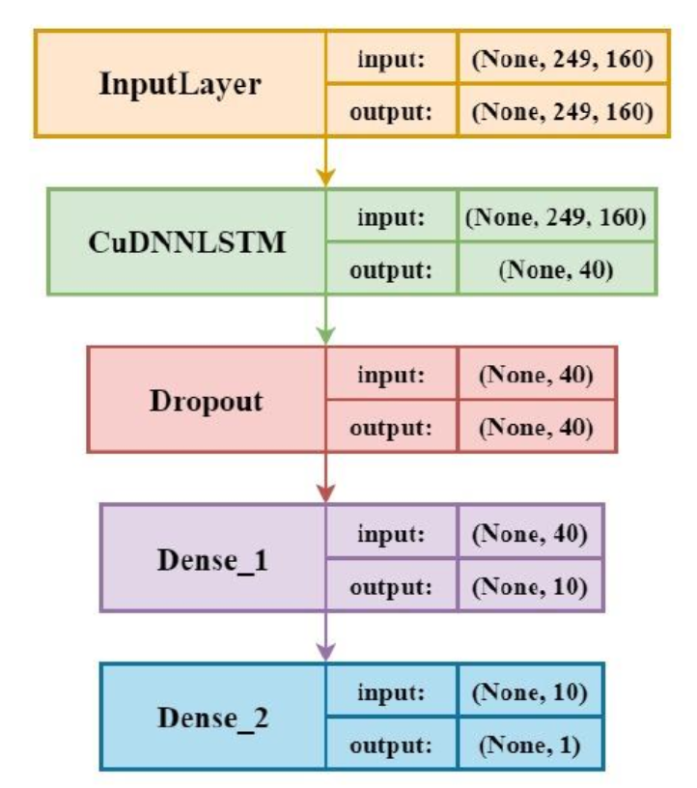
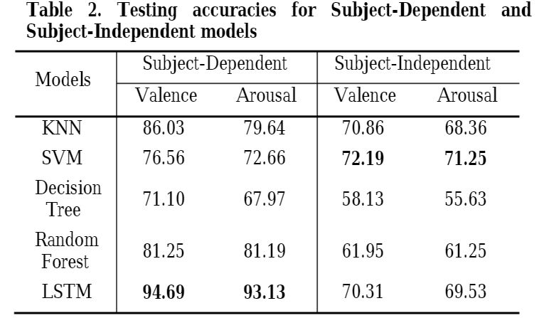
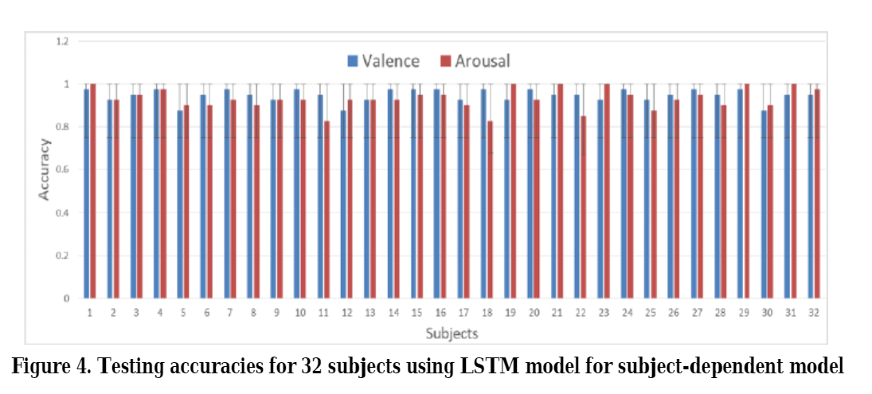
Papers Proposed LSTM model and accuracies

Slide 4
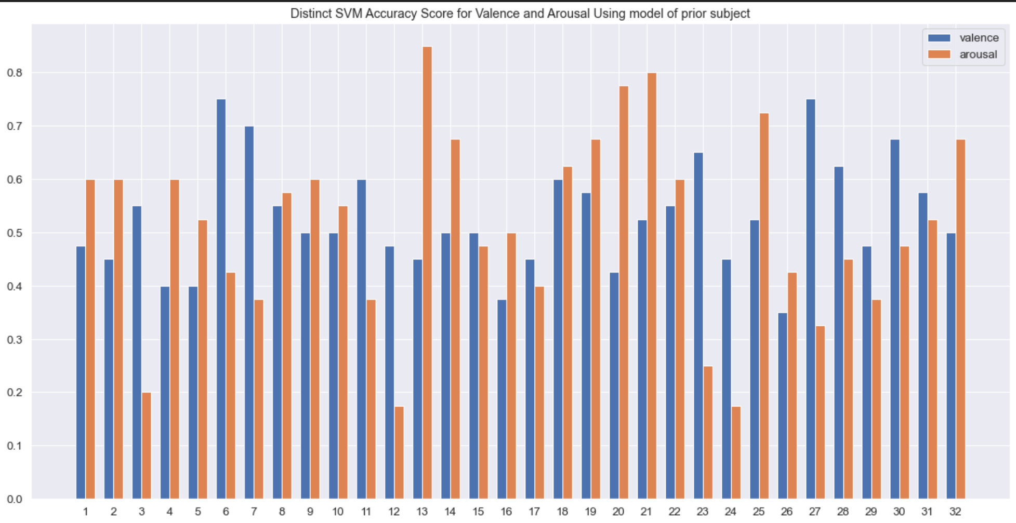
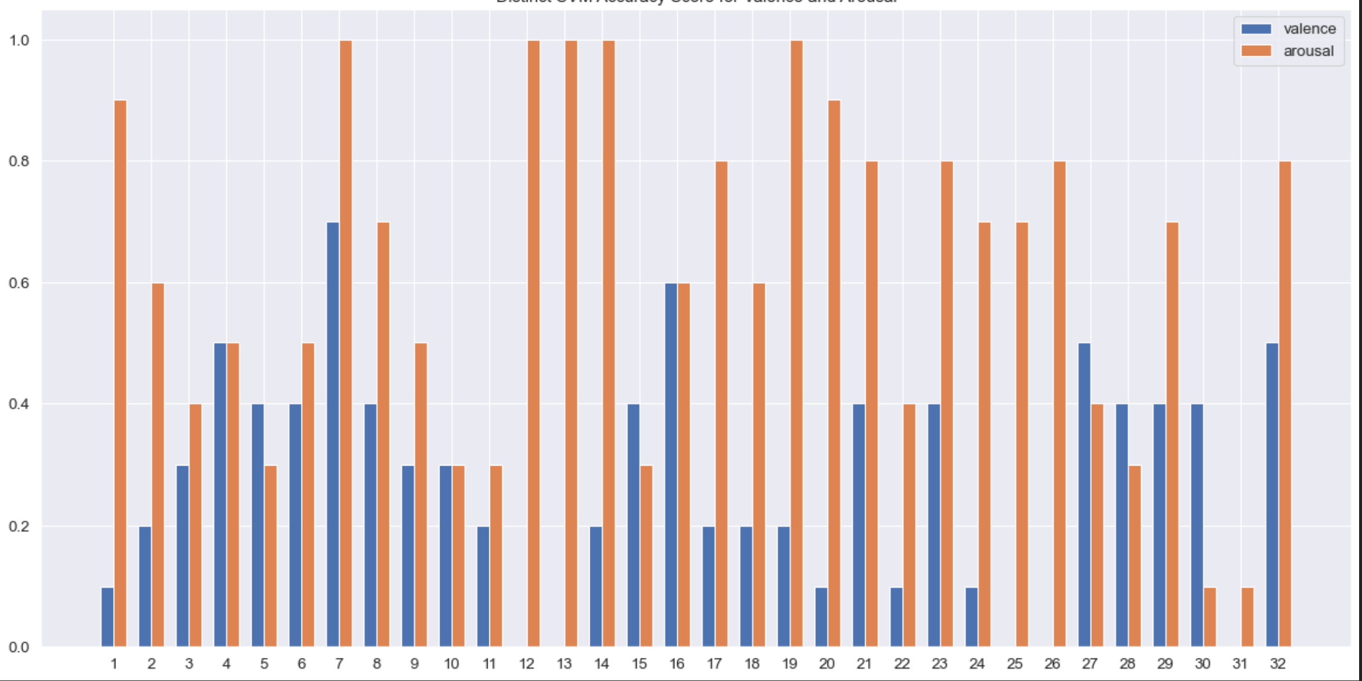
Accuracies I got from SVM
Train and test split from each subject
Train from current subject and test from previous subject

Slide 5
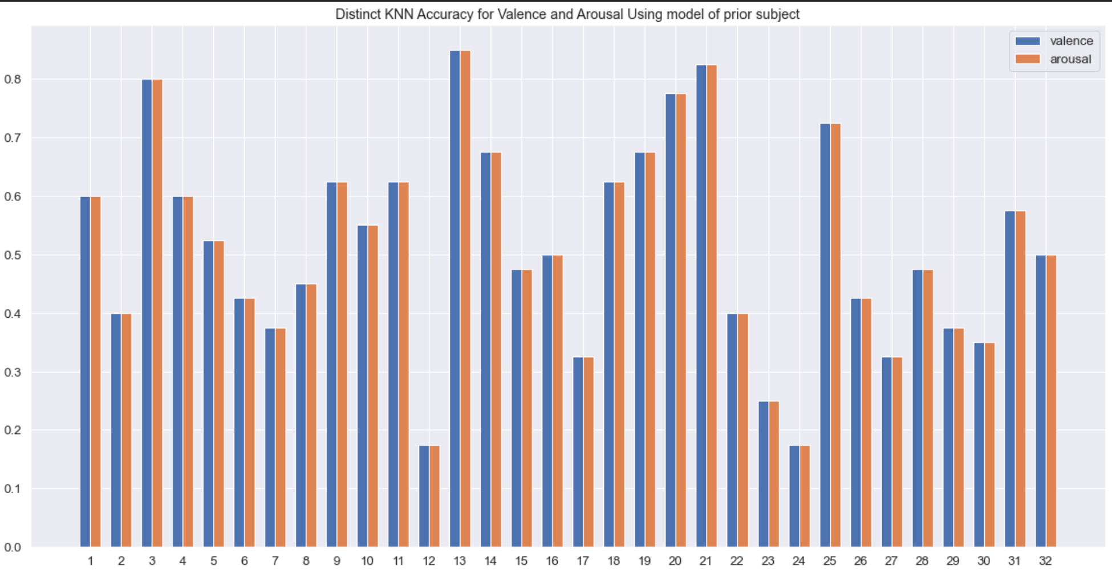
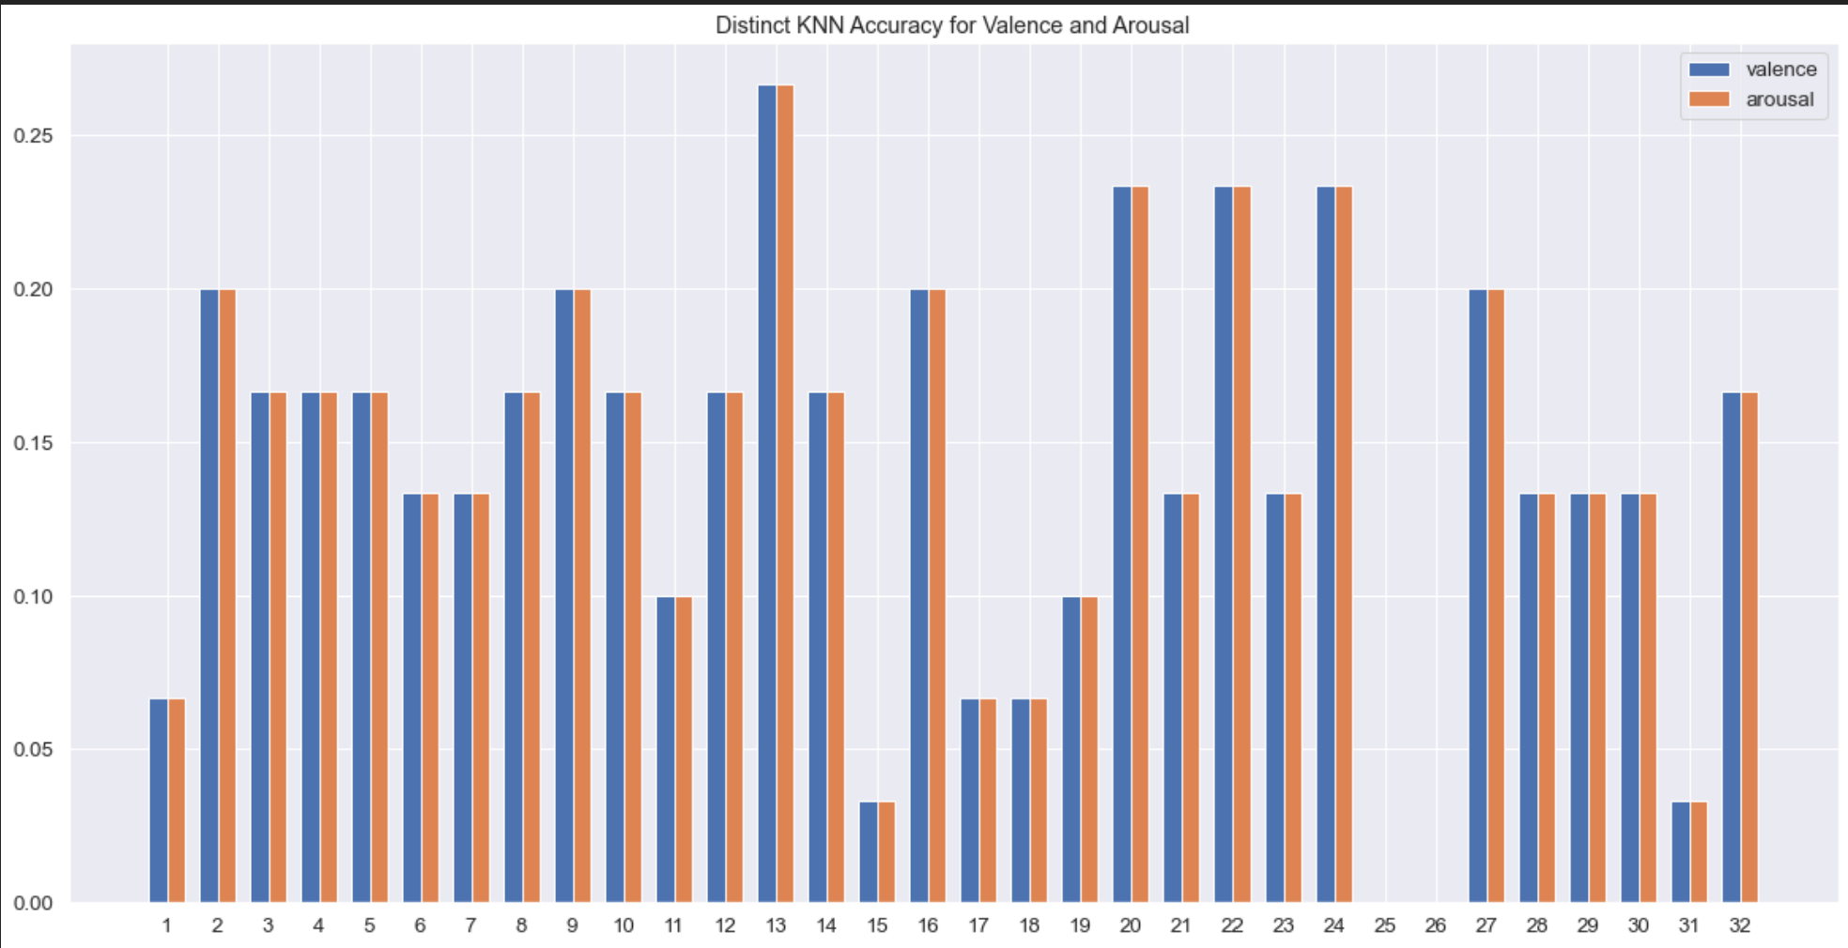
Accuracies I got from KNN
Train and test split from each subject
Train from current subject and test from previous subject

Slide 6
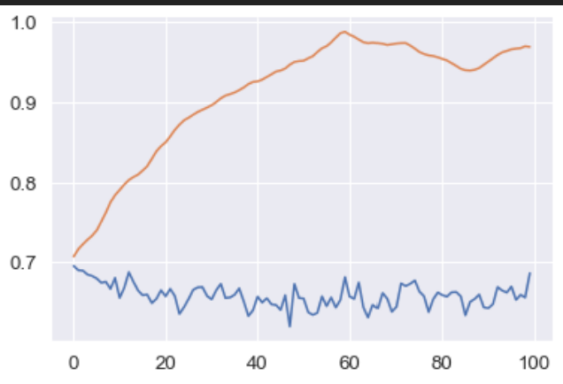
Proposed Model Train and Validation Loss
Overfitting

